Slide 1
Recovery Advocacy in Action
Preparing for Stand Up For Recovery Day 2020!

Slide 2
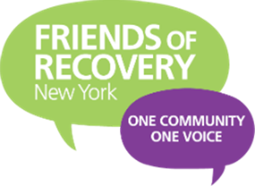
.
Your Presenters:
Allison Weingarten, FOR-NY
Ashley Livingston, FOR-WW
Richard Buckman, LIRA

Slide 3
.
Presentation Outline
Our Government Structure
How our advocacy works
Our Vision
How to contact your elected officials
How to look up legislation
Working on your advocacy message
Action plan to engage your elected officials

Slide 4
.
What is Advocacy?
To write, act, speak out in support of a cause
A tenet of social justice campaigns for change Activism
Engaging legislators: meetings, letters, calls
Media activities: i.e. news conferences, editorial board visits, op-eds, letters to the editor.
Grassroots activities such as rallies, vigils, walks
Community Listening forums, town halls, call in days.

Slide 5
.
Our Government Structure: Federal Government
US Congress has 2 chambers; the Senate and the House of Representatives
Each chamber has own leadership, committee structure, and set of rules
Senators serve 6 year terms, elections staggered
House Reps serve 2 year terms
Mid term elections: Can affect Congress control
The U S Congress is responsible for passing federal legislation and appropriating funds.

Slide 6
.
Federal Government: New York
US Senate: 50 Senators 2 from each state regardless of population
Chuck Schumer, Kirsten Gillibrand
US House of Representative 435 members. Each state is guaranteed one representative and then based on population additional seats, which are adjusted after census.
NY has 27 seats same as Florida (Ca, Tx have more)
22-Democrats 5-Republicans

Slide 7
Our Federal Advocacy has paid dividends
2008 MHPAEA: (1996 Federal parity bill). Our movement began in earnest and our presence and voices grew significantly
2008 Affordable Care Act provided addiction coverages with full parity for 65 Million Americans
2015 Comprehensive Addiction Recovery Act (CARA)
2016 21st Century CURES Act $6 Billion public health & medical research bill
2018 HR6 Support for Patients & Community Act-Combat Opioid Epidemic
2019 Appropriations: Building Communities of Recovery BCOR funding 33%
$1 Million to establish a Peer Technical Assistance Center
$4 Million for workforce Development for individuals in recovery

Slide 8
.
Overview of State Lawmaking
In New York State more than 14,000 bills are introduced each year
About 2000 or <15% of these are acted on and less than 6% become law
NY Senate *63 members (62) counties
NY Senate 2019-2020 *39D-24R
Senate Leader: Andrea Stewart Cousins
Assembly Speaker-Carl Heastie
2019-2020 Assembly 150 members >105-44-1

Slide 9
Committees Relevant to Recovery Advocacy
Senate Alcohol Drug-Peter Harckham (Westchester)
Senate Health-Gustavo Rivera (Bronx)
Senate Insurance- Neil Breslin (Albany & Rensselaer)
Senate Finance- Liz Krueger (NYC)
Assembly Alcohol & Drug-Linda Rosenthal-(NYC)
Assembly Insurance-Kevin Cahill (Kingston)
Assembly Health-Richard Gottfried (NYC)
Assembly Ways and Means- Helene Weinstein (Kings)

Slide 10
.
NY State Senate Alcohol and Drug Committee 2019
Chair- Harckham (Westchester)
Ranking Member- Akshar (Binghamton
Gaughran- Nassau, Suffolk
Liu- Queens
Martinez- Suffolk
Parker ( Brooklyn-Kings)
Tedisco (Fulton, Hamilton, Herkimer, Saratoga, Schenectady)
Notes:
Ranking member: The most senior member of a congressional or state legislative committee from the minority party.
On many committees the ranking minority member, along with the chairman, serve as ex officio members of all the committee's subcommittees.
When party control of a legislative chamber changes, a committee's ranking minority member is likely, though not assured, to become the next chairman of the committee, and vice versa.

Slide 11
.
NY State Assembly Alcohol & Drug
Committee 2019
Linda Rosenthal-Chair (Manhattan)
Carmen E. Arroyo (Bronx)
Maritza Davila (Kings)
Michael G. DenDekker (Queens)
Joe DeStefano (Suffolk)
Nathalia Fernandez (Bronx)
Judy Griffin (Nassau
Mark Johns (Monroe)
John T. McDonald III (Albany, Rensselaer, Saratoga)
Melissa Miller (Nassau)
Dan Quart (NYC)
Michael Reilly (Richmond)
Karines Reyes (Bronx)
Al Stirpe (Onondaga)
Notes:
AND – in partnership with ASAP, we produce the NYS Recovery Conference!

Slide 12
NY State Joint Senate Task Force on Opioids, Addictions, and Overdose Preventions
CO-CHAIR- Carlucci (Rockland, Westchester)
CO-CHAIR- Pete Harckham (Westchester)
George A. Amedore, Jr. (Albany, Greene, Montgomery, Schenectady, Ulster)
Jamaal T. Bailey (Bronx, Westchester)
CO-CHAIR- Gustavo Rivera (Bronx)
Brian A. Benjamin (NYC)
Patrick M. Gallivan (Erie, Livingston, Monroe, Wyoming)
Betty Little (Clinton, Essex, Franklin, Saint Lawrence, Warren, Washington)
Monica R. Martinez (Suffolk)
Rachel May (Madison, Oneida, Onondaga)
Roxanne J. Persaud (Kings)
Diane J. Savino (Kings, Richmond (Staten Island)

Slide 13
OUR ADVOCACY WORKS
State Wins:
2014 Eleven total Bills passed improving insurance coverages
2016 Significant funding increases to OASAS (RCOC’s etc.)
additional insurance improvements
2018 A07689-A/S6544-B: Eliminating patient brokering in NYS.
2019 advocates around the state advocated for a recovery tax credit.
MAT access improvements
Notes:
In 2018 A07689-A/S6544-B: An act to amend the mental hygiene law, in relation to prohibited practices by providers of substance use disorder services was passed and signed into on law on Aug 8th, 2018. This eliminated patient brokering in NYS.
In 2019 advocates around the state advocated for a recovery tax credit. Governor Cuomo included this idea into the state budget. This first in the nation legislation was passed on March 31st, 2018. Starting in 2020, up to $2 million will be allocated for this program annually, with employers receiving a maximum credit of $2,000 for each eligible person they hire. The New York State Office of Alcoholism and Substance Abuse Services will administer the program in conjunction with the Department of Taxation and Finance.

Slide 14
Building a sphere of influence
Our early history included a targeted strategy aimed at developing relationships with key (influential) legislators and relevant Senate and Assembly committee chairs. This groundwork and strategic planning has served us well in recent years.
Long Island was particularly influential with the Senate during the years 2008-2018 with Senate leaders Dean Skelos & John Flanagan both from Long Island and an all Republican LI Senate delegation referred to as the “Long Island nine”.
For several years we heard that’s great we know Long Island is at the table but we need to hear from others elsewhere. FOR-NY has made that part of our mission targeting other RCO’s and adding important voices through strategic coordination i.e., FOR-DO and Senator Seward (Insurance Committee)
We are seeking to further expand the influence of our communities of recovery statewide by identifying and coordinating (adding faces and voices) from all areas of NY State (Connective Tissue)

Slide 15
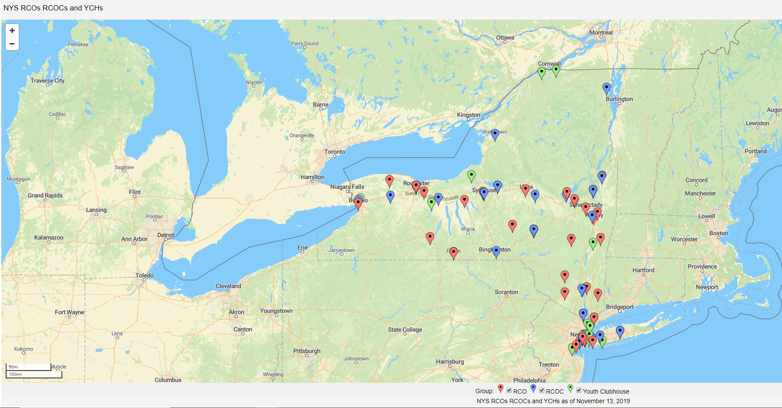

Slide 16
.
How Advocacy Works
Have an idea about an issue of importance- For example delayed access to medication assisted treatment
Organize- bring others together around that issue: who else is invested in this issue, are there other advocacy organizations working on this issue?
Do your homework- is there already legislation introduced on this issue? If yes, write a letter in support, if no, work with your elected officials to draft legislation to correct the issue
Advocate- Hold rallies, hold educational forums, meet with elected officials- both local- geographically and issue based- committee chairs that impact that issue for example: the insurance committee
Be persistent- DON’T GIVE UP! Keep organizing and keep advocating until we win!
Notes:
AND – in partnership with ASAP, we produce the NYS Recovery Conference!

Slide 17
.
How to set up meetings with your elected officials for Stand Up For Recovery Day:
Identify the people who will be going from your group to Albany
Get addresses of the individuals (this is how you will find their elected officials)
To find Assembly Members follow this link: https://nyassembly.gov/mem/search/ Enter the address you collected from your group members to identify their officials.
To find Senators follow this link: https://www.nysenate.gov/find-my-senator Enter the address you collected from your group members to identify their officials
Once you have the officials identified call their Albany offices so you can obtain the Albany Schedulers email address.
Send the email requesting an appointment for Stand Up for Recovery Day between 1:30pm-3pm. Typically the scheduler will want to know the topic of the meeting, what issues will be discussed, how many attendees there will be, and if the attendees are constituents.
Notes:
AND – in partnership with ASAP, we produce the NYS Recovery Conference!

Slide 18
.
Example Email
Dear (Insert schedulers name or officials name),
(RCO‘s name or groups name) will be in Albany on (date) for Friends of Recovery NY’s Stand Up for Recovery Day. We would like to schedule a meeting with (officials name) on (date) to discuss the needs of the recovery community in (senate or assembly district #). We are looking to schedule a meeting between (time frame) and hope you can schedule this meeting for us. We know that the (officials name) may be in session during this time and are not opposed to meeting with the Chief of Staff, the Legislative Director, or legislative staff. Thank you for your time. Please don’t hesitate to reach out to (your contact information or contact persons information) if you have any questions regarding this meeting.
Have a wonderful day!
Sincerely,
(your name)
(your contact information)
Notes:
AND – in partnership with ASAP, we produce the NYS Recovery Conference!

Slide 19
.
Timeline for Requesting meetings
You should try and begin scheduling meetings 1-2 months prior to Stand Up for Recovery Day (start now!)
You can also call district offices to schedule appointments in your districts prior to SURD. This helps develop relationships with your officials.
Once you have sent the initial meeting request if you have not heard from your officials within 2 weeks do a follow up call to the Albany office, reminding them you have a meeting request in with the scheduler.
Continue calling and emailing every 2 weeks or so until you get your appointment,
If you are scheduling multiple appointments, it may be helpful to keep a spreadsheet of the officials the meeting time and location.
Notes:
AND – in partnership with ASAP, we produce the NYS Recovery Conference!

Slide 20
.
HERE
HERE
Recording your Meetings
Once you schedule your meeting, please record it here!
https://friendsofrecoverynewyork-my.sharepoint.com/:x:/g/personal/aweingarten_for-ny_org/EfN9rmaoevZAv-omZ-5SkKoBfCIs482lyQTpRAxbBdv1kw?e=dgmogx
Notes:
AND – in partnership with ASAP, we produce the NYS Recovery Conference!

Slide 21
.
How to Look up legislation
Federal Legislation
Go to https://www.congress.gov
You can search legislation by its number or by a topic.
House of Representative bills start with HR and have a number. (Ex. HR248- Mainstreaming Addiction Treatment Act of 2019)
Senate bills start with S and have a number (Ex. S2074- Mainstreaming Addiction Treatment Act 2019)
Notes:
AND – in partnership with ASAP, we produce the NYS Recovery Conference!

Slide 22
.
How to Look up legislation
State Legislation
Assembly
For Assembly bills go to https://nyassembly.gov/leg/
You can search legislation by its number.
Assembly bills start with A and have a number. (Ex. A8774B- Relates to the establishment of a program for the use of medication assisted treatment for inmates)
State
For Senate bills go to https://www.nysenate.gov/legislation
You can search legislation by its number.
Senate bills start with S and have a number (Ex. S8914A- Relates to the establishment of a program for the use of medication assisted treatment for inmates)
Notes:
AND – in partnership with ASAP, we produce the NYS Recovery Conference!

Slide 23
.
Working on Your Advocacy Message
General outline for an effective pitch
Introduce yourself and quickly describe who you are and what connects you to the issue you are pitching
State your case
Suggest how the listener can resolve the problem
Explain how you can help the listener in resolving the problem
BEFORE YOU END
End with a call to action—a future meeting or a phone call to continue the conversation—Keep them engaged! [“When can we talk again?”]
Ask for a business card and supply one as well if possible
Notes:
AND – in partnership with ASAP, we produce the NYS Recovery Conference!

Slide 24
Action Plan to Engage your Elected Officials
Choose an issue that is important to you. (see our policy statement for examples!)
Organize: Who else supports this issue and can help you with it
Information collecting- does any legislation already exist on this issue?
What action can you take around this issue: hosting a forum, attending a rally, meeting with elected officials
Craft your message:
How do you connect to the recovery community and this issue
What data supports the changes you want to make
State your case: what do you want changed and why
Share with decision makers how you can continue to work together to make positive change
Schedule follow-up meeting
Send a thank you letter after your face-to-face meeting

Slide 25
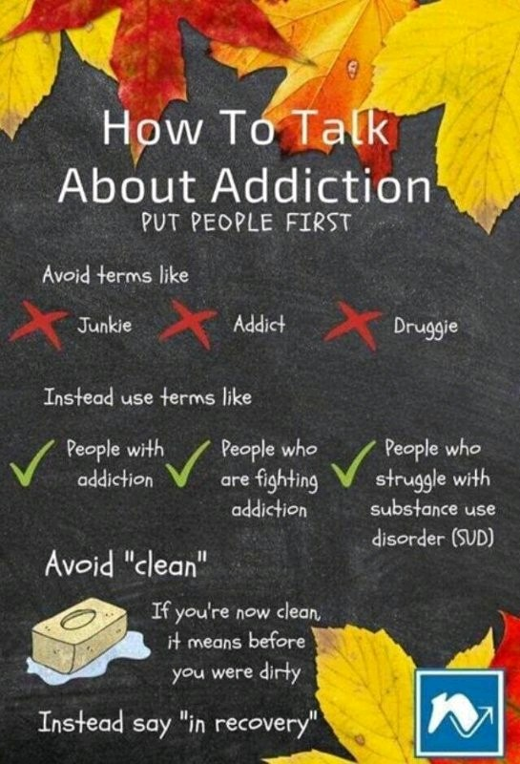
.
Things to consider when crafting your message
“Words are important. If you want to care for something, you call it a ‘flower;’ if you want to kill something, you call it a ‘weed.’”
– Don Coyhis
Notes:
AND – in partnership with ASAP, we produce the NYS Recovery Conference!

Slide 26
The Grassroots Lobbying Plan 230 Washington Ave Extension, Suite 101 Albany NY 12203 (518)-462-6805

Slide 27
Questions & Answers

Slide 28
Connect with Us!
Allison Weingarten, LMSW
Director of Policy
Friends of Recovery- New York
aweingarten@for-ny.org
518-487-4395 Ext. 22
Ashley Livingston, CRPA
Co-Chair
FOR- Warren & Washington
gettin2brighterdays@gmail.com
Richard Buckman LCSW-R CEAP CASAC CRPA CARC
Co-Founder
Friends of Recovery- New York
Founding Member-Immediate Past Pres.
Long Island Recovery Association
rbuckman@lirany.org

