Slide 1
Stand Up For Recovery Day 2021 Advocacy Toolkit
How to Engage with Lawmakers

Slide 2
.
Advocacy Toolkit Outline
How to set up a meeting with your Legislator
Example Email
Contact Timeline
Zoom Meeting Outline
Crafting your message

Slide 3
.
How to set up meetings with your elected officials for Stand Up For Recovery Day:
Identify the people who will be attending our virtual event from your area. Find your Recovery Ambassador here.
On Stand Up For Recovery Day we meet with NYS Senate and Assembly Members to educate them about recovery. We will do local and federal outreach days on other days.
To find Assembly Members follow this link: https://nyassembly.gov/mem/search/
To find Senators follow this link: https://www.nysenate.gov/find-my-senator

Slide 4
.
How to set up meetings with your elected officials for Stand Up For Recovery Day:
Once you have the officials identified, find their email address on their webpage and email them to set up an appointment for Tuesday February 9, 2021 between the hours of 1pm and 3 pm.
Typically the scheduler will want to know the topic of the meeting, what issues will be discussed, how many attendees there will be, and if the attendees are constituents.
In this age of virtual meetings, you will need to obtain a zoom account or another platform of which to hold the meeting
Once the meeting is scheduled, please send all information to aweingarten@for-ny.org
AND input the meeting information here.

Slide 5
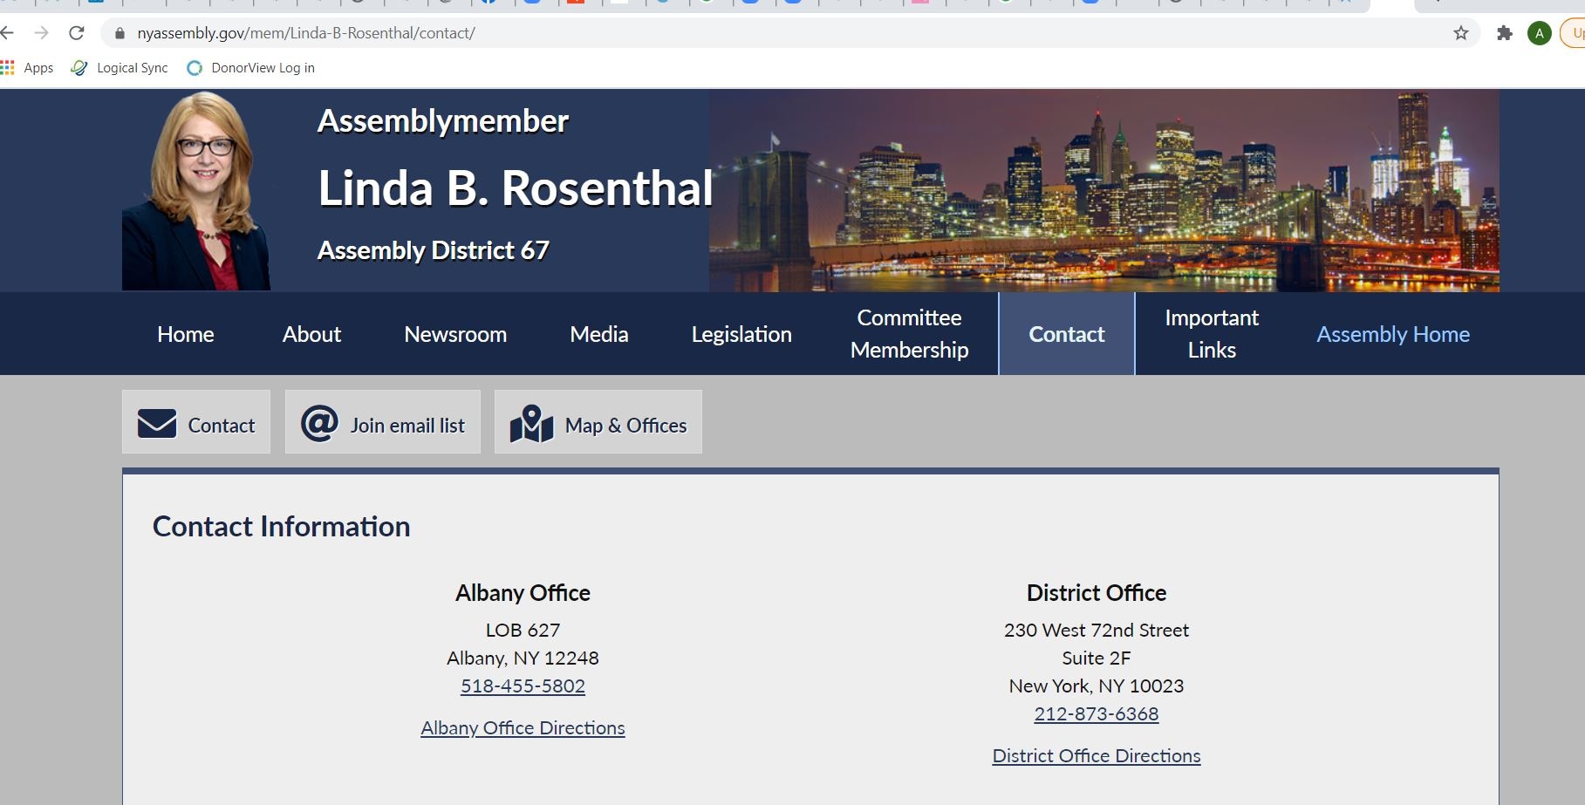
.
Contact Example
Contact here!

Slide 6
.
Example Email
Dear (Insert schedulers name or officials name),
(RCO‘s name or groups name) will be taking part in Friends of Recovery NY’s Virtual Stand Up for Recovery Day on Tuesday February 9, 2021. We would like to schedule a meeting with (officials name) to discuss the needs of the recovery community in (senate or assembly district #). We are looking to schedule a meeting between (time frame) and hope you can schedule this meeting for us. We know that the (officials name) may be in session during this time and are not opposed to meeting with the Chief of Staff, the Legislative Director, or legislative staff. Thank you for your time. Please don’t hesitate to reach out to (your contact information or contact persons information) if you have any questions regarding this meeting.
Have a wonderful day!
Sincerely,
(your name)
(your contact information)

Slide 7
.
Timeline for Requesting meetings
You should try and begin scheduling meetings 2 months prior to Stand Up for Recovery Day
You can also call district offices to schedule appointments in your districts prior to SURD. This helps develop relationships with your officials.
Once you have sent the initial meeting request if you have not heard from your officials within 2 weeks do a follow up call to the Albany office, reminding them you have a meeting request in with the scheduler.
Continue calling and emailing every 2 weeks or so until you get your appointment,
If you are scheduling multiple appointments, it may be helpful to keep a spreadsheet of the officials the meeting time and location.

Slide 8
.
Zoom Meeting Outline
For your Zoom Meeting- you will need to decide what role meeting participants will play:
Facilitator: The person who will introduce the group; introduce the goal of the call or video call and facilitate who speaks when. The facilitator should also be prepared to thank the legislator for previous accomplishments regarding recovery. This starts the meeting out on the right path. The facilitator will be responsible for reading the room and determining how much time the legislator or staff person has to meet and will have to think on their toes about who get to speak and when. You should always give the legislator and/or staff person time to introduce themselves as well and state their connection to the cause.
Note Taker: The note takers can have the role of collecting all contact information, taking notes on what was said, sending follow up notes and background materials (policy statement, information on local resources, and more)

Slide 9
.
Zoom Meeting Outline - Continued
For your Zoom Meeting- you will need to decide what role meeting participants will play:
Speakers: Different members should be prepared to share their personal story and contribute to speaking about the policy statement as well as speaking to the important recovery services your community provides. The more meeting participants have a connection to the policy statement, the more effective it will be. Speakers should practice what they are going to say. Keep it short- 1 minute or so each.
2 Zoom Moderators: Two people should be designated to monitor the Zoom. One person can let people into the zoom room (ensuring there are no “zoom bombs”) and one person should be designated to read the chat and share questions with the facilitator as they come in.

Slide 10
.
Zoom Meeting Outline - Continued
Example Meeting Outline:
Opening: Facilitator introduces themselves, introduces the organizations represented in the room, thanks the elected official/staff members for their time and for their help on recovery issues in the past and briefly introduces this year’s policy statement and goals. The facilitator could ask everyone to add their email addresses into the zoom chat. Then the Facilitator says “Assembly Member/Senator, would you like to introduce yourself?”

Slide 11
.
Zoom Meeting Outline - Continued
Example Meeting Outline (continued):
After the Elected official or staff members introduces themselves, then the facilitator will say- we have several individuals in recovery and family members who will speak briefly to our policy statement
Example: COVID-19: Person in recovery speaks to how COVID-19 has impacted their recovery experience
Example: Racial Justice: Person in recovery who is also a person of color speaks how they have been impacted by the “double stigma”
Example: Housing: Person in recovery who has benefited from recovery housing and expresses the need for more, safe options with access to MAT
Example: Treatment- family member speaks to their experience getting personalized treatment for their son or daughter and how that needs improvement
Example: Recovery Oriented Systems of care: representative from local RCO could speak to the need for more peers in the community
Example: Transportation: person in recovery can speak to how accessible transportation is so necessary in recovery

Slide 12
Zoom Meeting Outline - Continued
Example Meeting Outline (continued):
Closing: Facilitator will ask elected officials if they have any questions and thank them for their time. The note taker should copy and paste the zoom chat (which will have email addresses included of all meeting participants).
After the meeting: Note taker will send out notes and follow up materials to all those present in the meeting

Slide 13
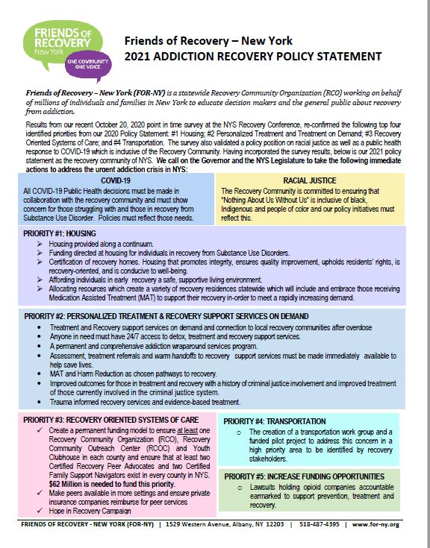
Crafting Your
Message-
Use the policy statement for guidance, tailor your message to your local community

Slide 14
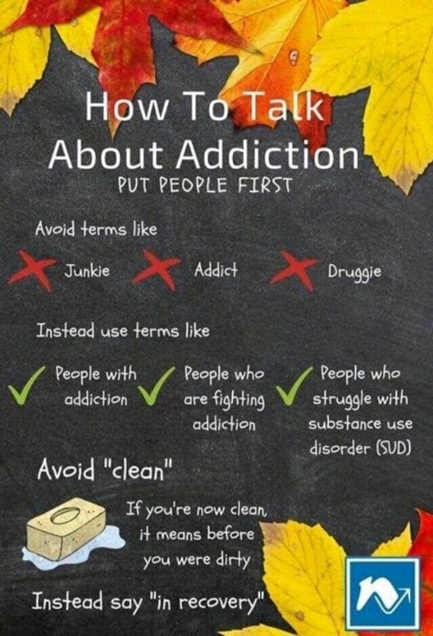
.
Things to consider when crafting your message
“Words are important. If you want to care for something, you call it a ‘flower;’ if you want to kill something, you call it a ‘weed.’”
– Don Coyhis

Slide 15
Other Meeting Tips
Practice Meeting with your group one or two times prior to the meeting
It is helpful to provide a script or at least an outline to your group prior to the meeting
Make sure everyone has correct call-in information

Slide 16
Meeting Follow up
Make sure to send an email thank you note, reiterating what was discussed and including helpful materials (policy statement, organizational brochure, contact information, etc)
Sending a thank you letter (snail mail!) is always a nice touch as well
Include the elected officials in upcoming events and meetings, keep the conversation and the relationship going!

Slide 17
Thank You
On behalf of Friends of Recovery New York (FOR-NY) thank you for your time, your commitment and your service!
“Never doubt that a small group of thoughtful, committed citizens can change the world; indeed, it's the only thing that ever has.” - Margaret Mead
If you have additional questions or comments, please feel free to contact our Director of Policy Allison Weingarten at aweingarten@for-ny.org

